Slide 1
Ischemic classification summary

Slide 2
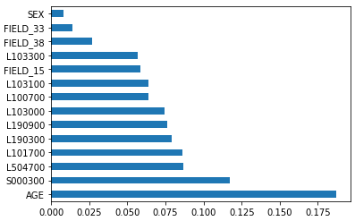
Ischemic classification
Total data size: 535169
Normal: 530,428
Hyperlipidemia: 4,741
Features:
AGE
BMI
L190900 - red blood cell distribution width
L103300 - Cardiac risk factor
L504700 - Bowel disease
L190300 - RBC
L103100 - HDL-cholesterol
L100700 - Uric Acid
SEX
L103000 - Triglyceride
L101700 - r-GTP gamma
FIELD_15 - Whether one diagnosis (high blood pressure)
FIELD_38 - Drinking 5-1 days (1 week)
FIELD_33 - 4-1 Smoking
 | Data size
Training size | 5,879
Testing size | 400

Slide 3
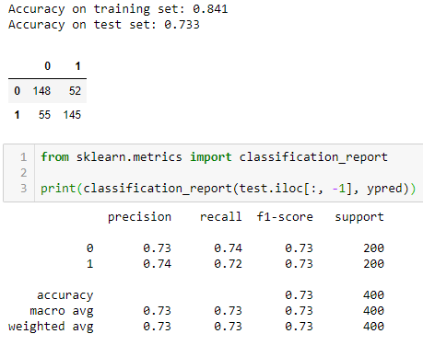
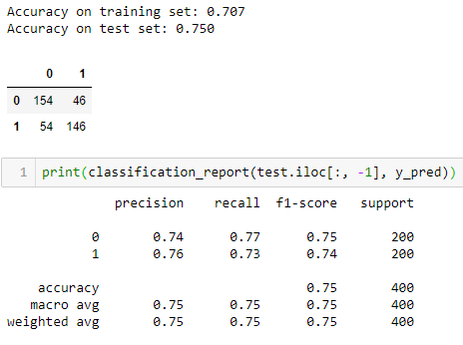
Ischemic classification
Random Forest Classifier
XGB Classifier

Slide 4
Ischemic next year prediction
Data size
People who show up two years continuously: 193,691
After columns are selected and null values removed
Features:
AGE
BMI
L190900 - red blood cell distribution width
L103300 - Cardiac risk factor
L504700 - Bowel disease
L190300 - RBC
L103100 - HDL-cholesterol
L100700 - Uric Acid
SEX
L103000 - Triglyceride
L101700 - r-GTP gamma
FIELD_15 - Whether one diagnosis (high blood pressure)
FIELD_38 - Drinking 5-1 days (1 week)
FIELD_33 - 4-1 Smoking
 | This year | Next year
Class 0 | 191,888 | 192,278
Class 1 | 1,842 | 1,452
 | Training | Testing
Class 0 | 878 | 100
Class 1 | 220 | 100

Slide 5
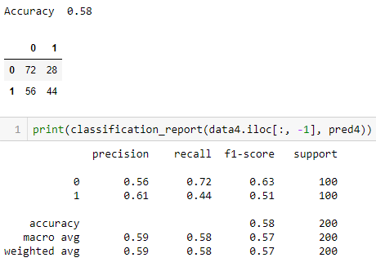
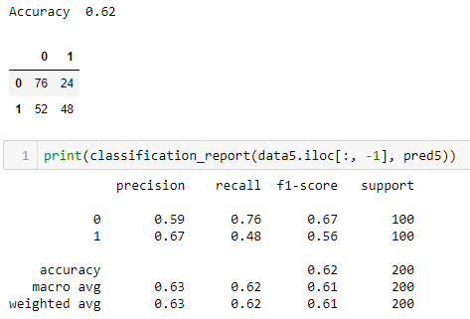
Hyperlipidemia next year prediction
Random Forest Classifier
Classifier training and prediction result on the actual data
Classifier prediction result on the next year forecasted dataset

